Slide 1
IIT Madras Computer Centre
P.G. Senapathy Centre for Computing Resources
SECUREVAULT
Remote Code Execution (RCE) – STAGE 3
September 2026

Slide 2
Project Objective
What was demonstrated?
Primary Goal
Lab Goal
Security Goal
Demonstrate how an unrestricted file-upload feature can become Remote Code Execution when executable PHP files are accepted and stored in the web root.
Create a reproducible Docker environment where the complete request → upload → PHP execution → command execution path can be observed.
Understand the root cause, prove impact safely, and show how the upload feature should be secured.
Key statement
Unauthenticated unrestricted upload + executable web-root storage
= controlled PHP server-side execution → RCE

Slide 3
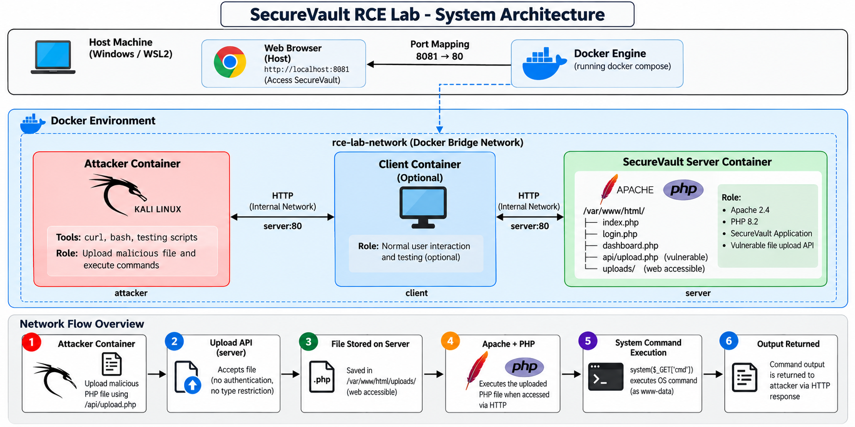

Slide 4
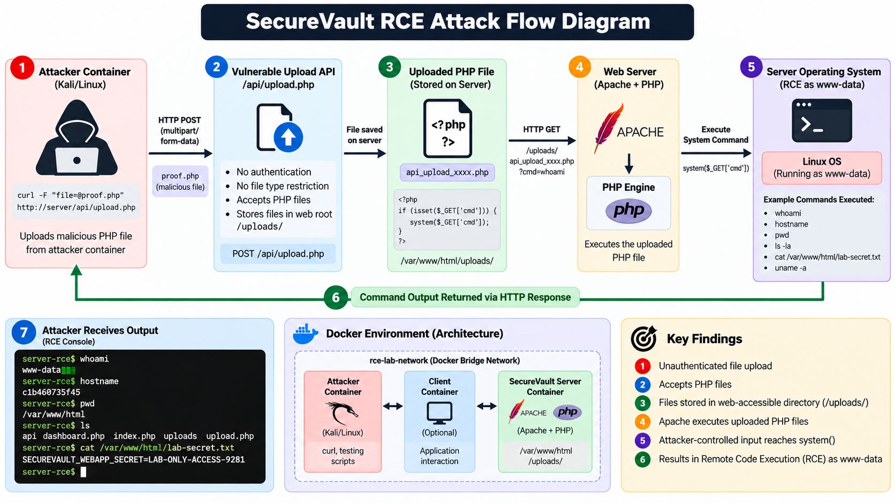

Slide 5
Security Problem
Why the upload feature is dangerous
• The upload API is reachable over the Docker network.
• No authentication/authorization check is enforced by the vulnerable API.
• No extension allowlist prevents .php uploads.
• Uploaded files are stored under /var/www/html/uploads.
• Apache/PHP interprets .php files in that directory.
• The RCE proof passes attacker-controlled input to PHP system().
Vulnerability chain
Remote input
File upload
.php accepted
Web-root storage
PHP execution
OS command
4+

Slide 6
Technologies Used
Components that make the lab reproducible
Docker
Container isolation
Docker Compose
Multi-service orchestration
Apache
HTTP web server
PHP 8.2
Server-side execution
curl
HTTP testing
Docker bridge network
Private service communication

Slide 7
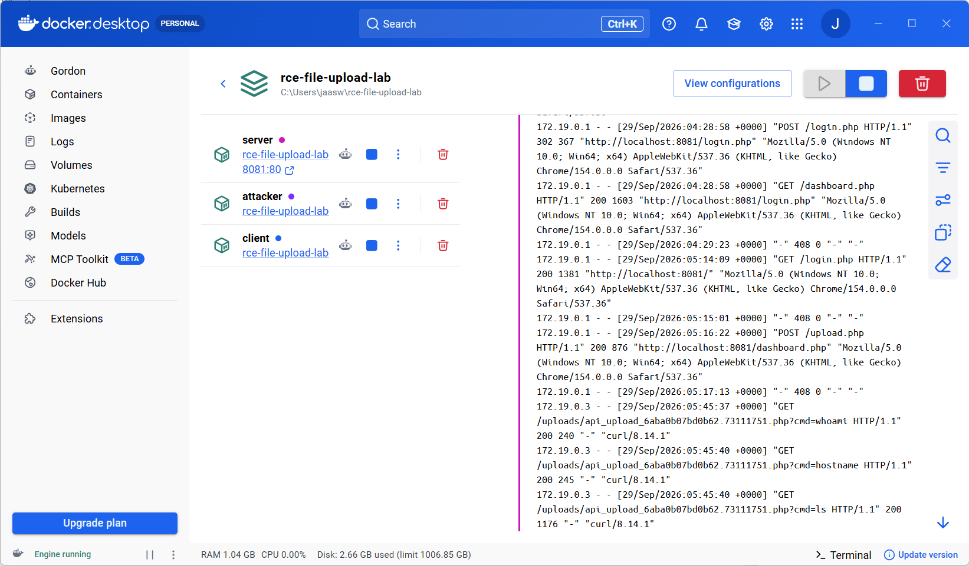

Slide 8
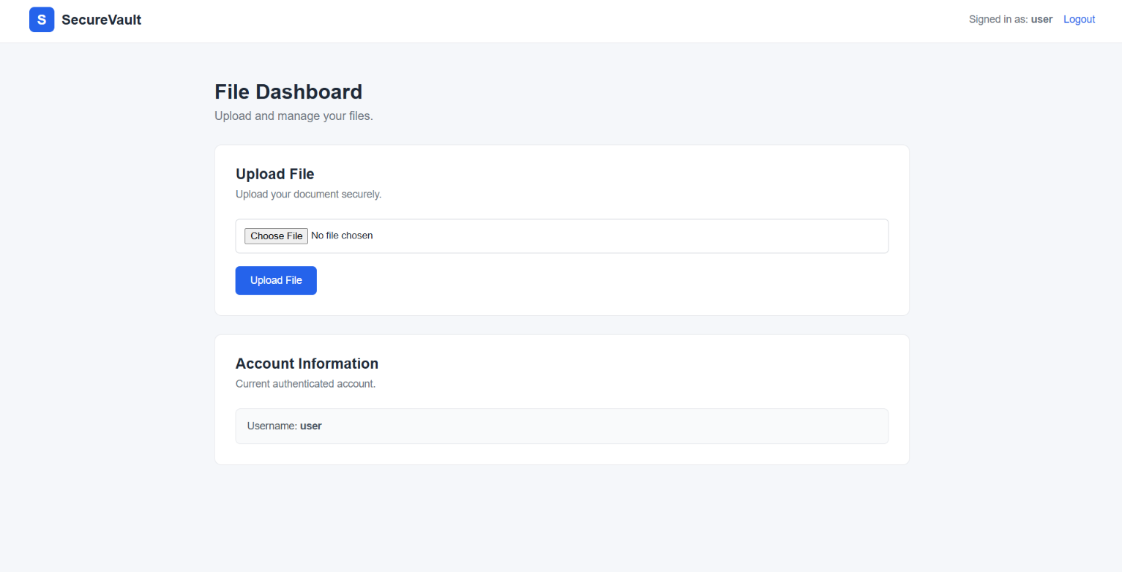

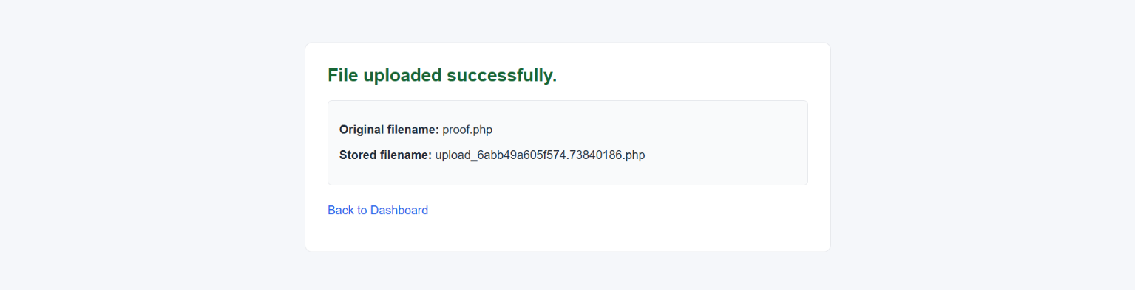

Slide 9
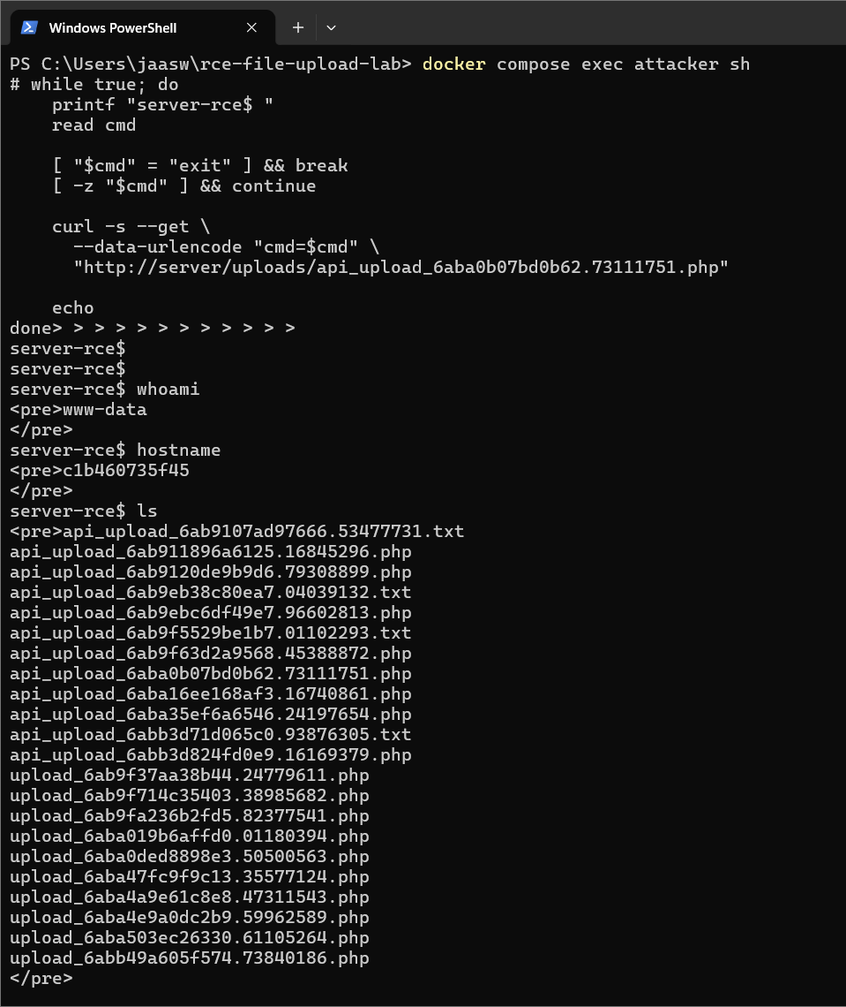
RCE Proof File
Controlled command execution proof
<?php
if (isset($_GET['cmd'])) {
echo "<pre>";
system($_GET['cmd']);
echo "</pre>";
} else {
echo "SecureVault RCE proof";
}
?>
Input
?cmd=whoami
Execution
PHP system()
Result
Command output over HTTP

Slide 10
Who Is Executing the Command?
The server-side process runs as the web-server account
HTTP request
from attacker
Apache / PHP
www-data
Linux command
execution
whoami → www-data
RCE does NOT automatically mean root access. RCE means remote execution.

Slide 11
Complete Attack Chain
End-to-end vulnerability flow
Discover upload API
Unauthenticated upload
Accept .php
Store in web root
Apache executes PHP
cmd reaches system()
OS command executes
Output returned
The vulnerability is the combination of unsafe upload handling and executable web-root storage, with the RCE proof providing the final command-execution step.

Slide 12
Conclusion
What the project demonstrates
UNRESTRICTED FILE UPLOAD
↓
PHP SERVER-SIDE EXECUTION
↓
REMOTE OS COMMAND EXECUTION (RCE)
The key lesson: user-controlled files must never become executable server-side code.

